Slide 1

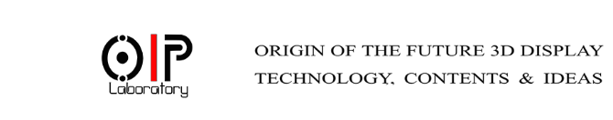

Faster Generation of CGH using DM-WRPs
Presented By: Md Sifatul Islam Id: 2017234017

Slide 2

Table of content
Introduction to Holography
Introduction to Wavefront Recording Plane
Distributed Multiple WRPs
Results

Slide 3
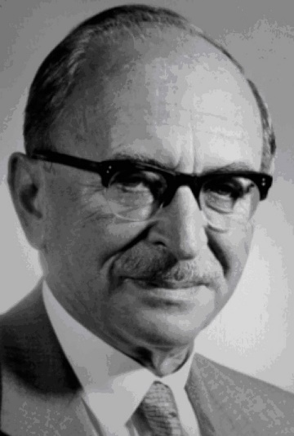
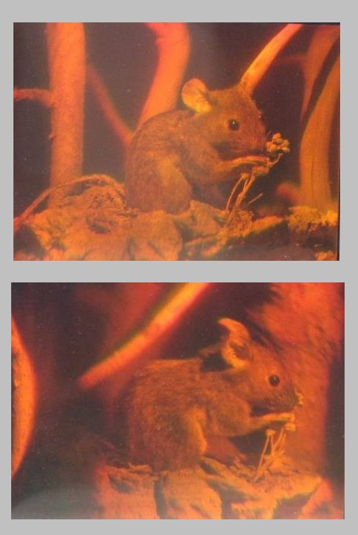
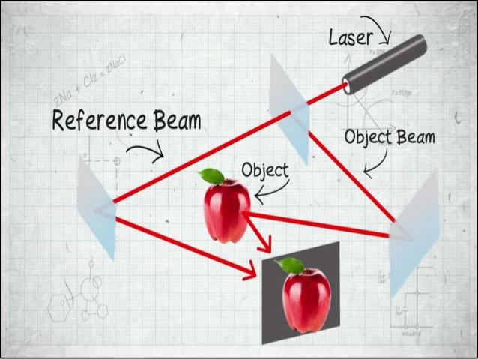
Hologram
1948 (first proposed)
1949
1950
1997 ( Novel Prize)
1960 (technology and concept improved)
Gabor recognized that when a suitable coherent reference wave is present simultaneously with the light diffracted by or scattered from an object, then information about both the amplitude and phase of the diffracted or scattered waves can be recorded.

Slide 4


Slide 5
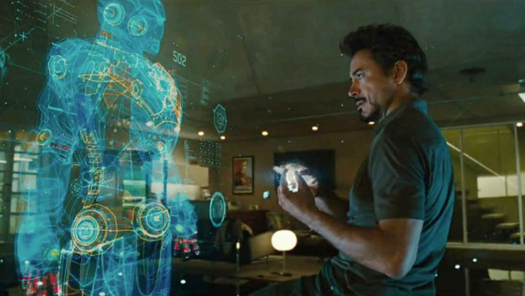
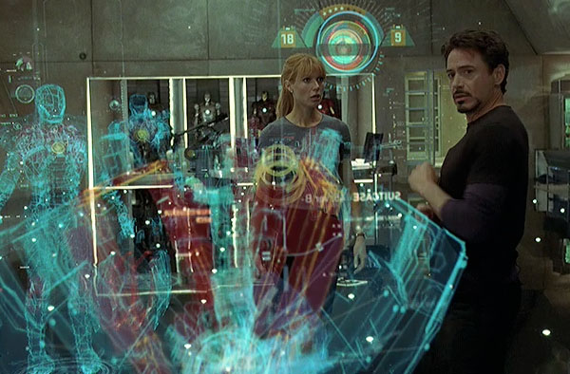

Slide 6

Hologram
Why I Chose digital holography?
Accurate Optical setup for Optical holography is hard
Experiments of Optical Holography are location dependent
Computer Generated Hologram (CGH) can also work with real word objects
CGH are easy to manipulate and then present in real world
Holography
Optical Holography
Digital Holography

Slide 7
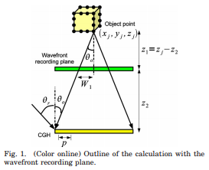
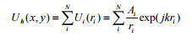

Wave front recording plane (WRP)
Complex amplitude on a CGH plane as U_{h} ( x, y ) , the object is composed of N points, and the complex amplitude on the CGH created by the i-th point in distance r_{i} is U_{i} ( r_{i} ). The final complex amplitude U_{h} ( x, y ) is expressed by by equation (1)
(1)
1
2
WRP calculates CGH in 2 steps:
The light wave from 3D objects is recorded on a WRP.
Light wave from the WRP to CGH is diffracted calculation based on fast Fourier transform (FFT)
1. Tomoyoshi Shimobaba, Nobuyuki Masuda, and Tomoyoshi Ito, "Simple and fast calculation algorithm for computer-generated hologram with wavefront recording plane," Opt. Lett. 34, 3133-3135 (2009)

Slide 8
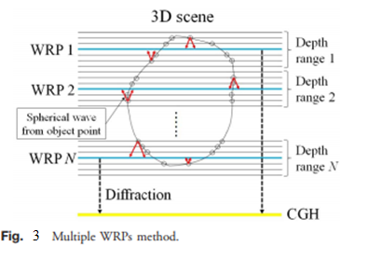
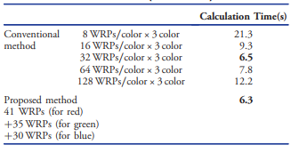
Multiple Wavefont Recoding Plane (MWRP )
3. N. Hasegawa, T. Shimobaba, T. Kakue, and T. Ito, "Acceleration of hologram generation by optimizing the arrangement of wavefront recording planes," Appl. Opt. 56, A97-A103 (2017).

Slide 9
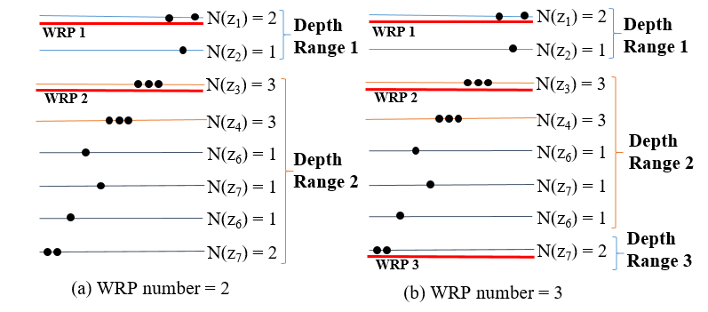
Distributed Multiple WRPs

Slide 10
Results
Object | No. of WRPs | Calculation Time
 |  | Conventional M-WRPs | Proposed DM-WRPs
Papilon | 2 WRPs | 1587.1 | -
 | 4 WRPs | 1574.3 | -
 | 8 WRPs | 1600.1 | 644.75
 | 10 WRPs | - | 636.24
 | 16 WRPs | 1624.0 | 641.85
 | 32 WRPs | 1668.2 | 659.69
 | 64 WRPs | 1673.9 | 705.49

Slide 11

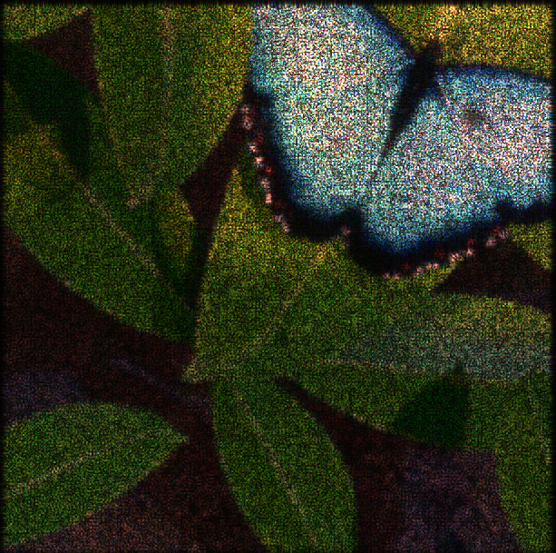
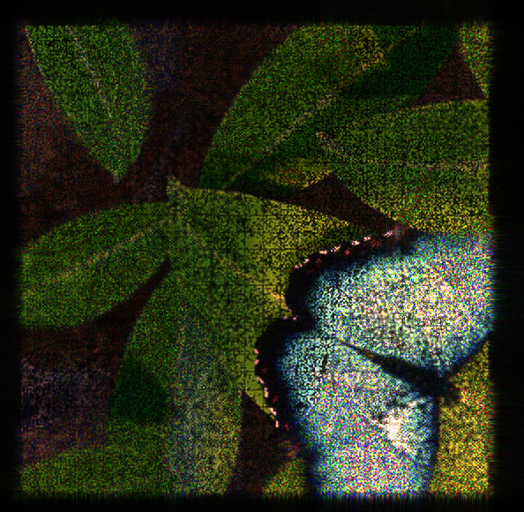
Results
a) Original Image
b) Conventional MWRPS
c) Proposed DM-WRPs

Slide 12
Future Work
Experiment with more full color objects
Optical simulation
Write journal paper
(WRP^{X}₁,WRP^{Y}₁)
(WRP^{X}₁,WRP^{Y}₁)

Slide 13
Thank you

Slide 14
Results
a) Conventional MWRPS
b) Proposed DM-WRPs

